Slide 1
AMS-301
Finite Mathematical Structure

Slide 2
Introduction
Syllabus: posted on QQ group
Office hours: TBD
Textbook: Alan Tucker, Sixth edition
Grade breakdown: see syllabus

Slide 3
Two Major Parts
Introduction to graph theory: Chapter 1-4
Isomorphism, edge counting, planar graph
Euler cycle, Hamilton circuit, graph coloring
Trees, search method, spanning trees, shortest path problem
Enumeration (counting): Chapter 5-8
Addition and multiplication principles, arrangement, selection
Repetition and distributions
Binomial identities
Generating function model
Recurrence relations, solution to recurrence relations
Venn diagram, set operations, inclusion and exclusion

Slide 4
Mathematics and Scientific Applications
The four color conjecture
Management, street-sweeper problem and postman problem
Data storage and retrieval
Risk and reliability analysis
Optimization
Classical probability

Slide 5
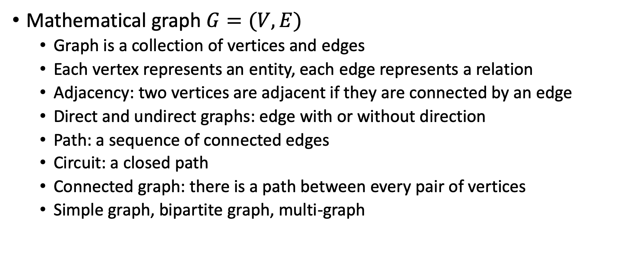
Graph Theory
Mathematical graph $G=(V,E)$
Graph is a collection of vertices and edges
Each vertex represents an entity, each edge represents a relation
Adjacency: two vertices are adjacent if they are connected by an edge
Direct and undirect graphs: edge with or without direction
Path: a sequence of connected edges
Circuit: a closed path
Connected graph: there is a path between every pair of vertices
Simple graph, bipartite graph, multi-graph

Slide 6
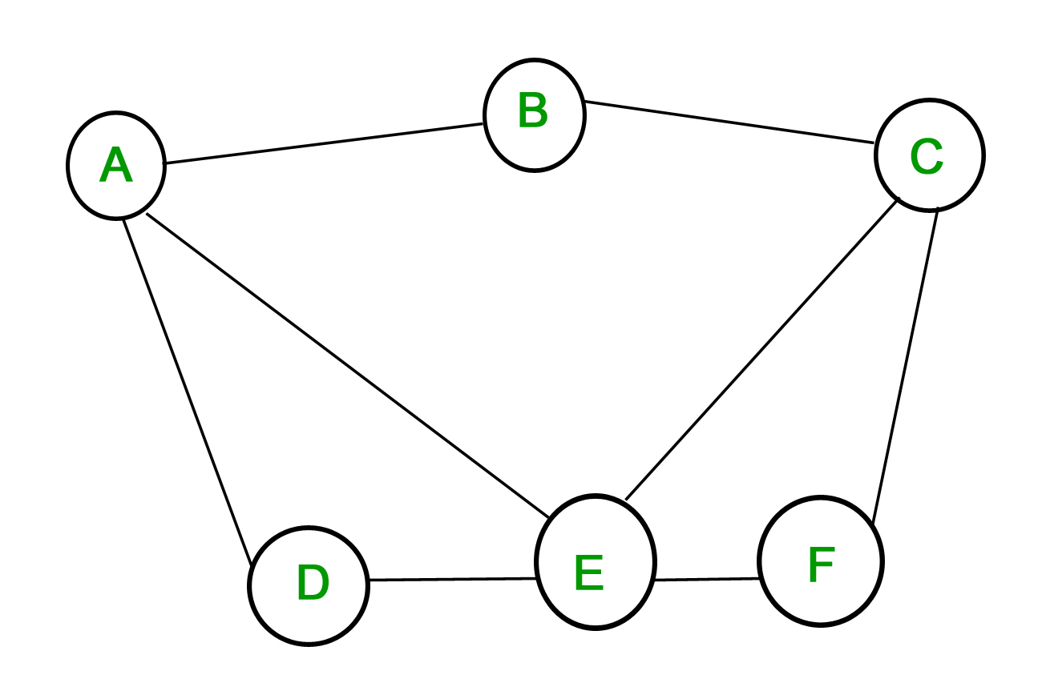
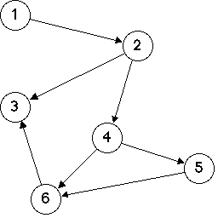
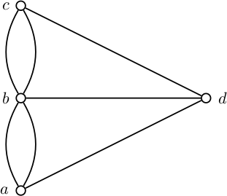
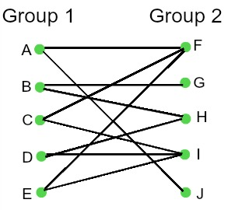
Variation of graphs
An undirected simple graph
A directed graph
A multigraph
A bipartite graph

Slide 7
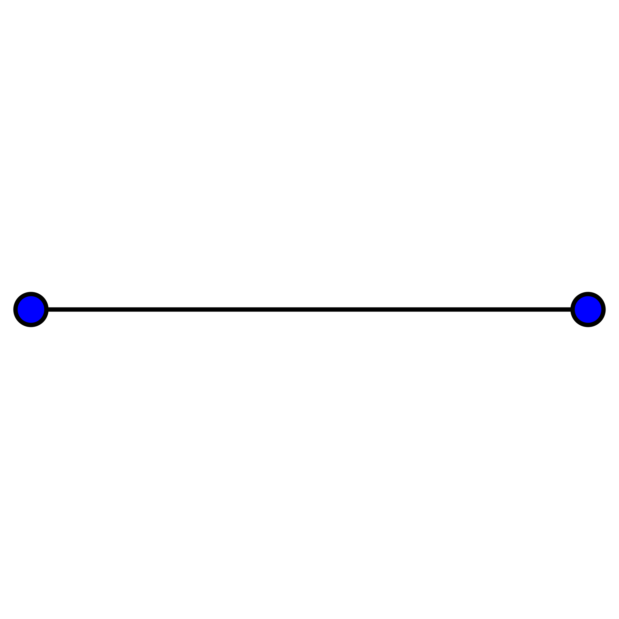
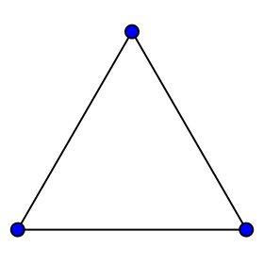
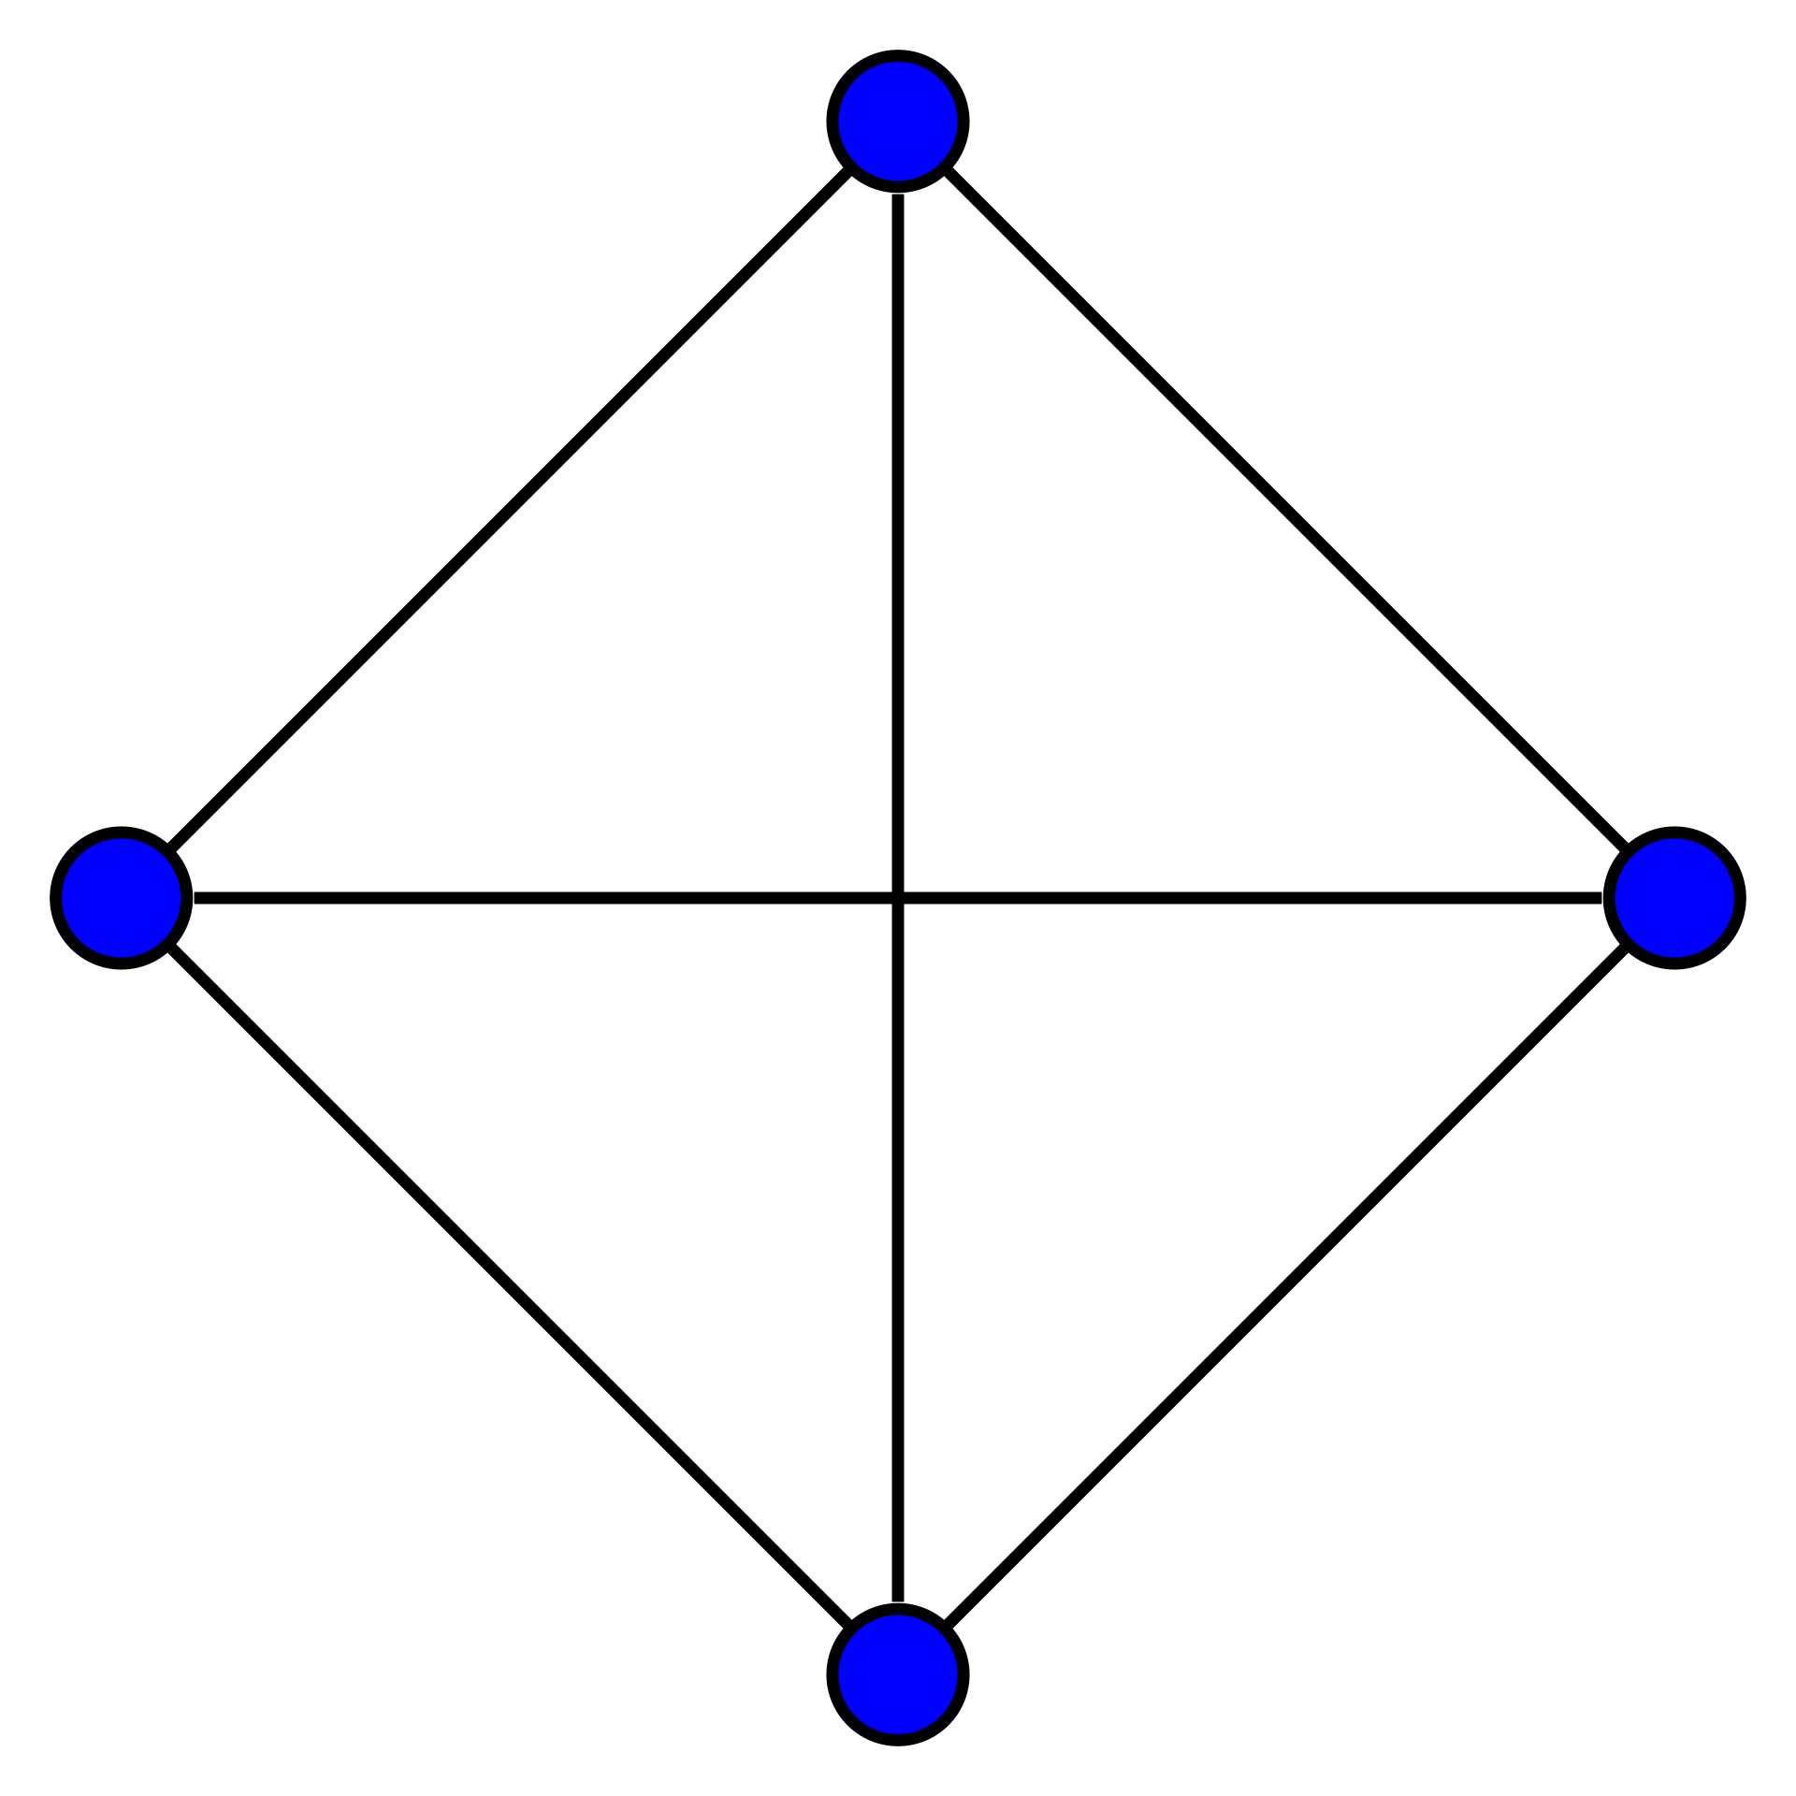
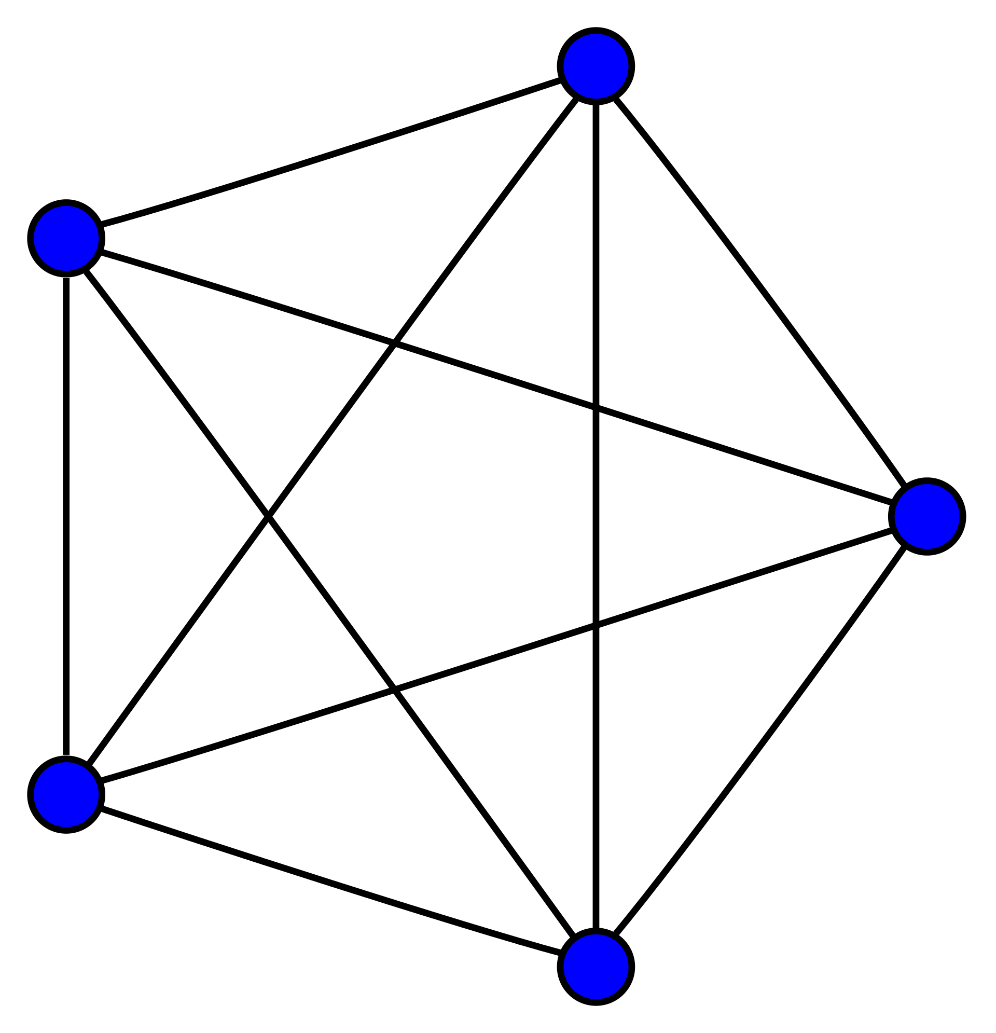
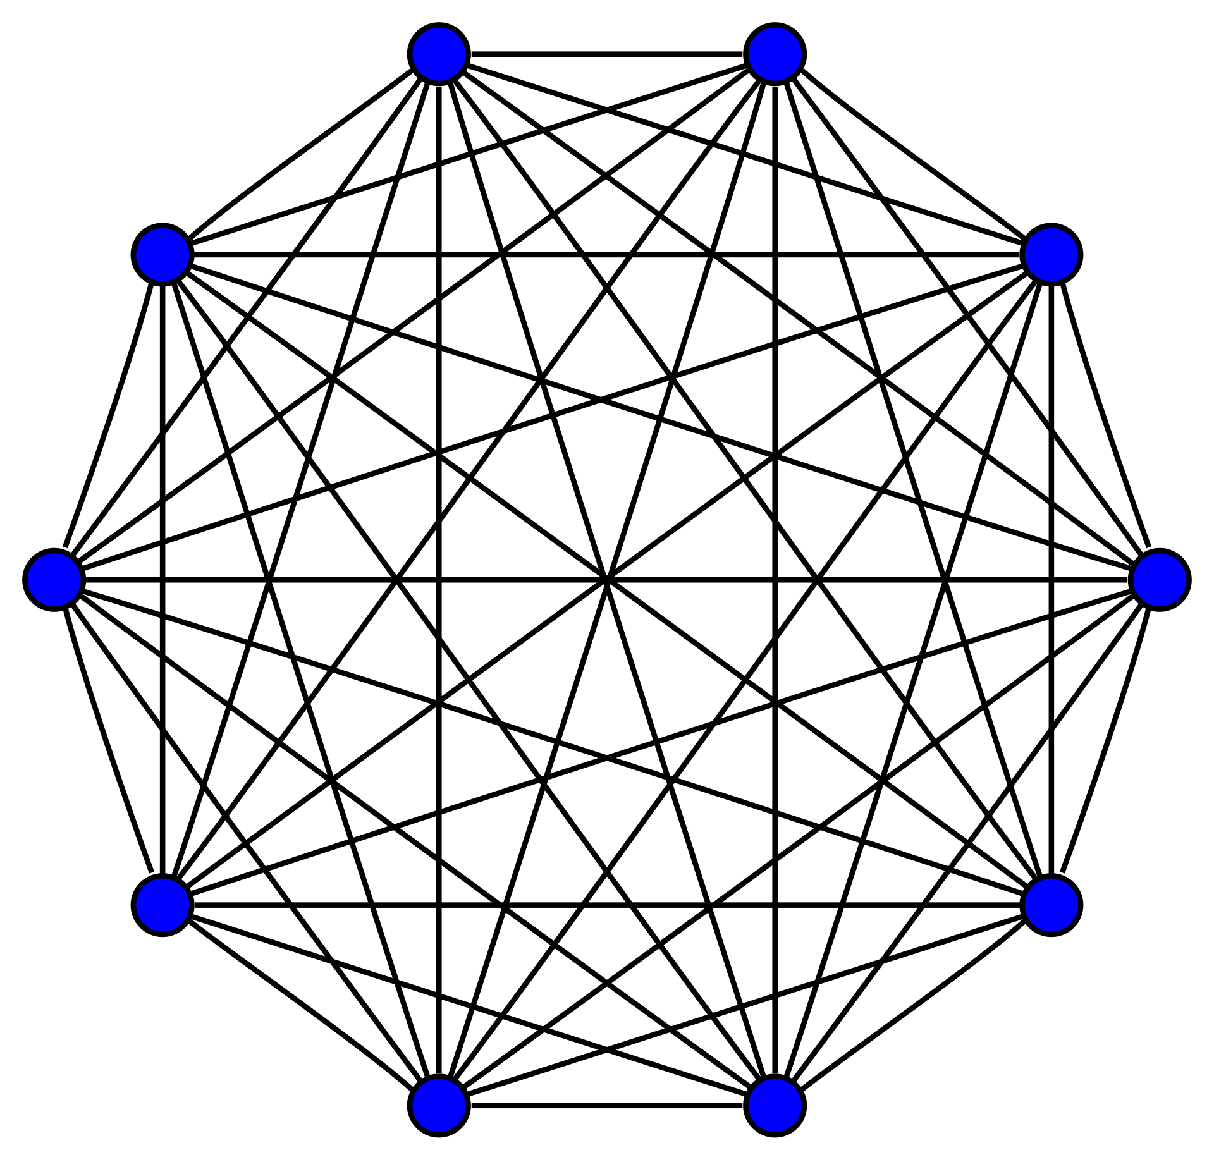
Complete graph
K2
K3
K4
K5
K10

Slide 8




Complete bipartite graph
$$K_{22}$$
$$K_{33}$$
$$K_{44}$$
$$K_{53}$$

Slide 9
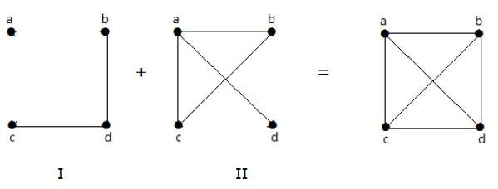
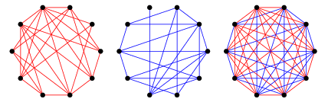
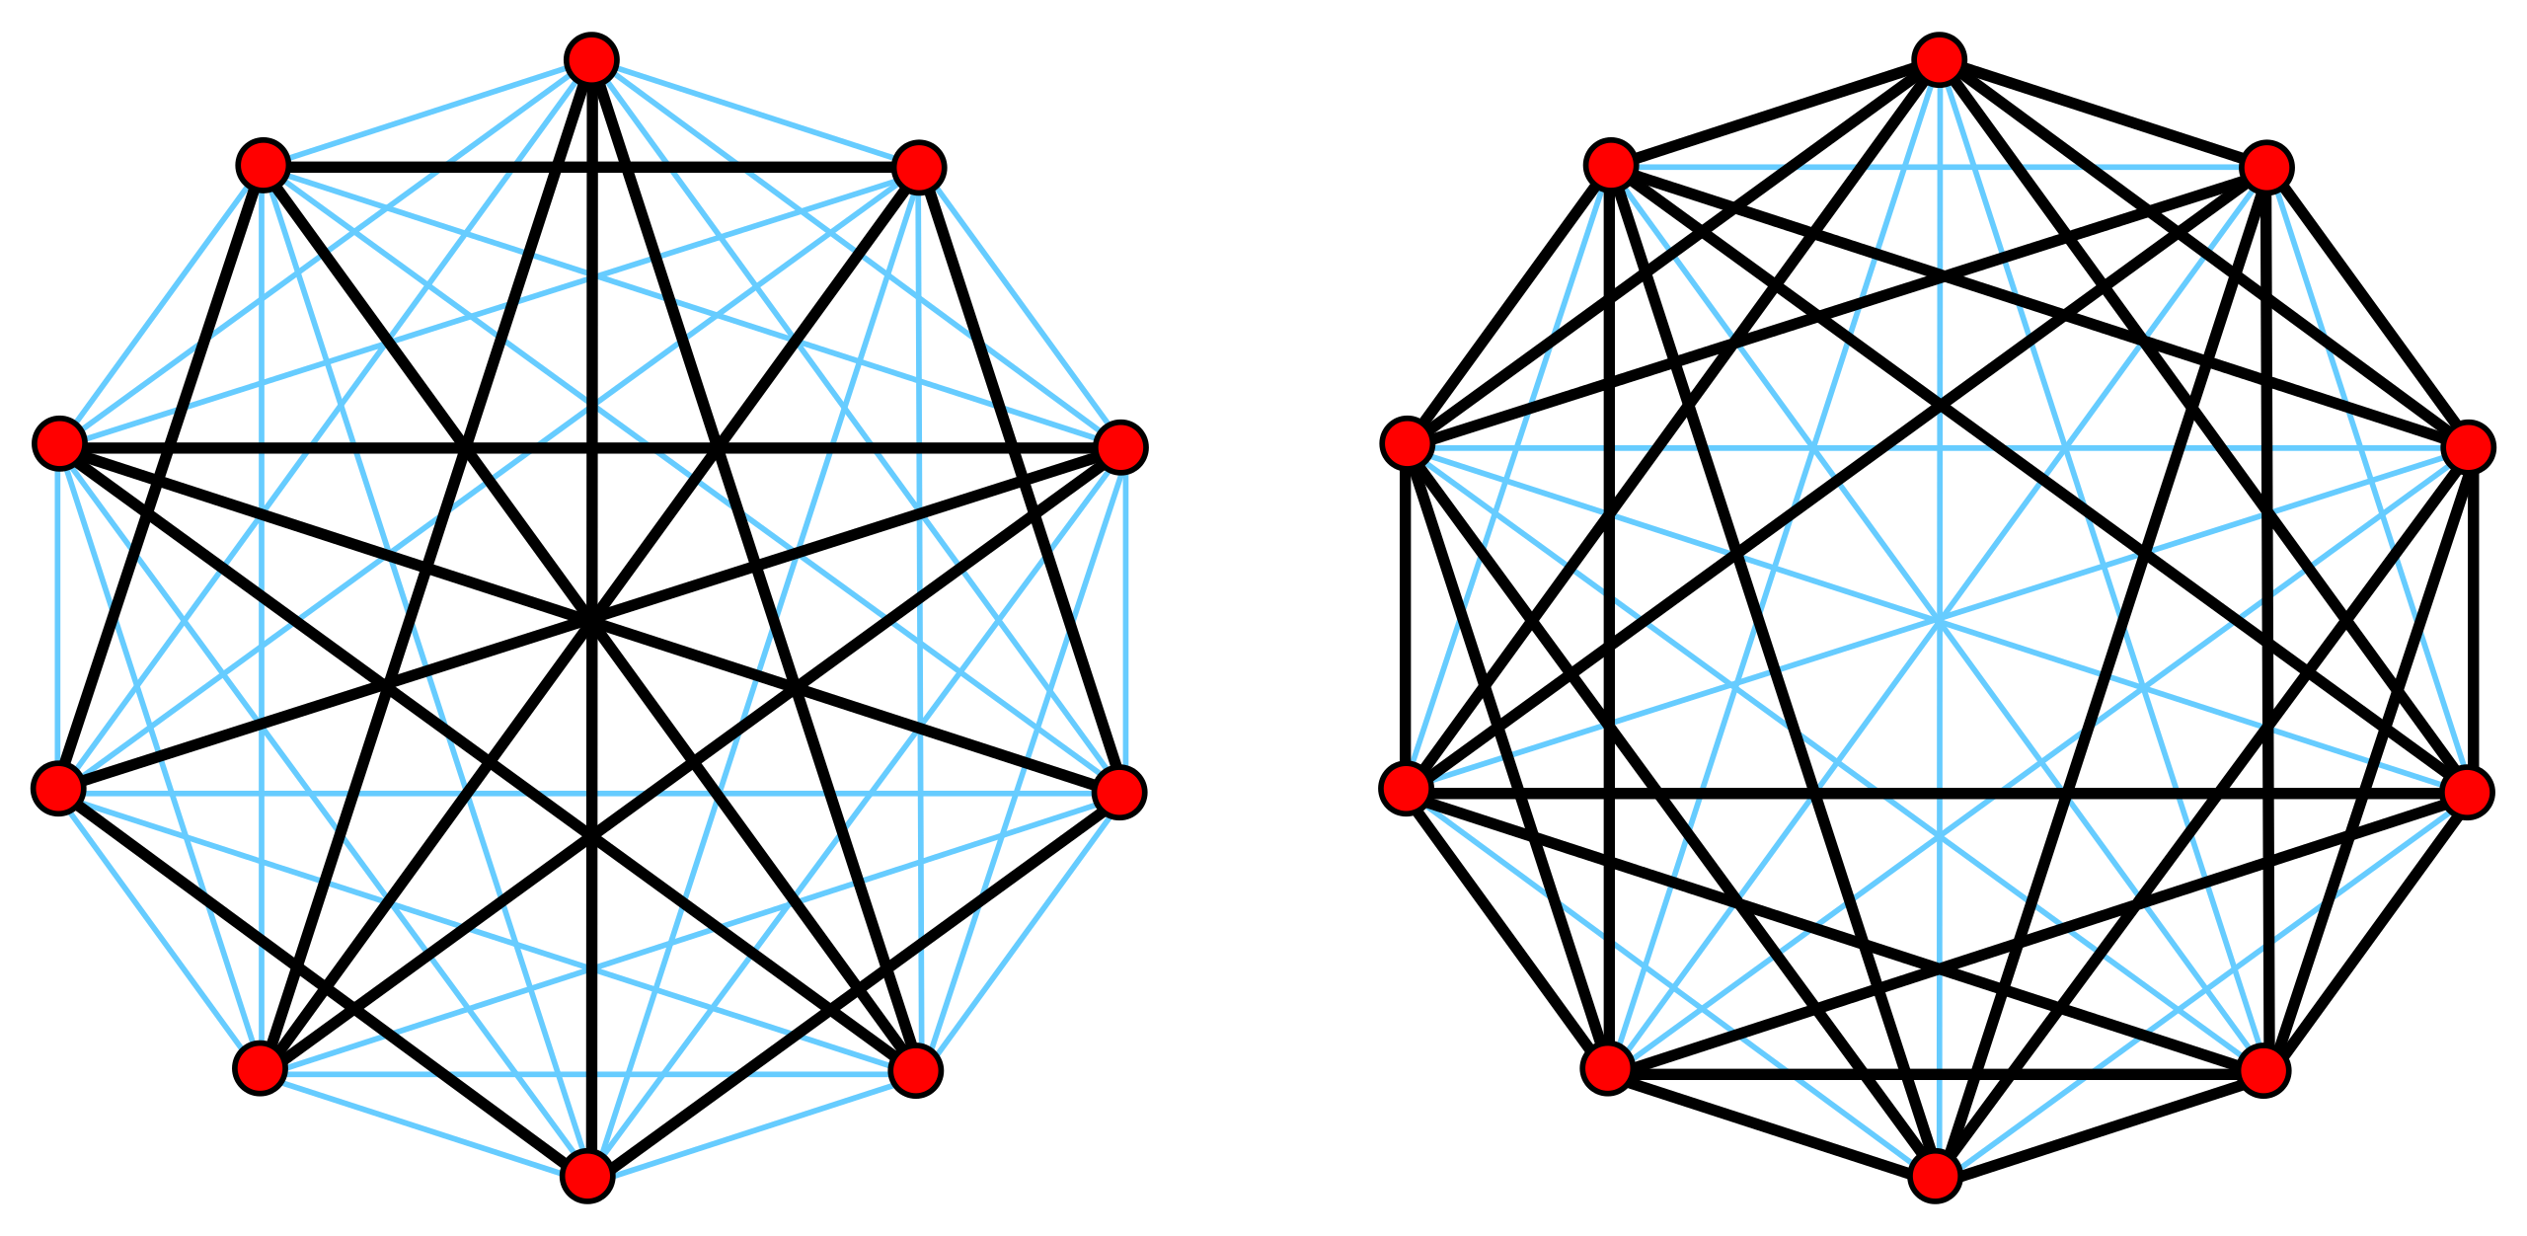
Complement of a graph
One important property: the more complex is the graph, the simpler is the complement

Slide 10
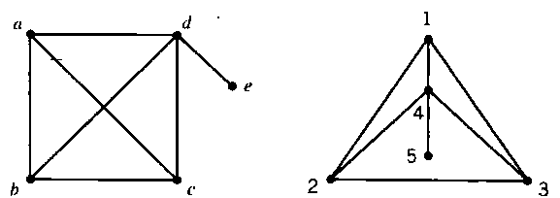
Subgraph
Subgraph is a subset of vertices and edges
There is a K4 subgraph in both graphs

Slide 11
Isomorphism
Consider two graphs:
They look different, but are they really different?

Slide 12
Isomorphism
Definition: two graphs G and G’ are isomorphic if there exists a one-to-one correspondence between the vertices in G and vertices in G’ such that a pair of vertices are adjacent in G if and only if the corresponding pair of vertices are adjacent in G’.
Find isomorphism between two graphs, especially two graphs with substantial complexity, is challenging and difficult. Here we will introduce some techniques to two identify relatively simple graphs.

Slide 13
Degree counting, a necessary condition
Degree: vertex degree is the number of incident edges to the vertex.

Slide 14
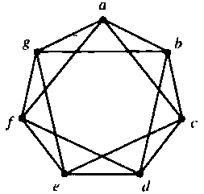
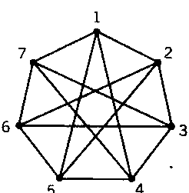
Application of symmetry
Two graphs are both symmetric. If there is an isomorphism, a can be associated with any vertex in the right graph: choose a - 1. Use AC Principle to try to continue isomorphism. Neighbors of a must match up with neighbors of 1. Consequently, we have: g-5,b-4; f-2,c-7; e-3,d-6.
AP principle: Assumption and consequence.

Slide 15
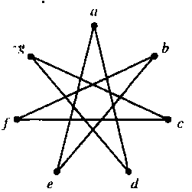
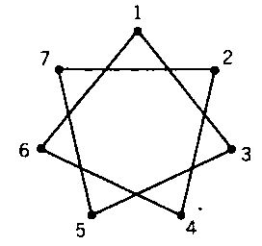
Applying complements
If the complements are isomorphic, so are the original graphs

Slide 16
The four color theorem
The conjecture: The four color theorem, or the four color map theorem, states that, given any separation of a plane into contiguous regions, producing a figure called a map, no more than four colors are required to color the regions of the map so that no two adjacent regions have the same color.
History: It was first proposed on October 23, 1852 when Francis Guthrie, while trying to color the map of counties of England, noticed that only four different colors were needed. Guthrie's brother, Frederick at University College London. then took it to De Morgan.
Outcome: The four color theorem was proved in 1976 by Kenneth Appel and Wolfgang Haken.

Slide 17
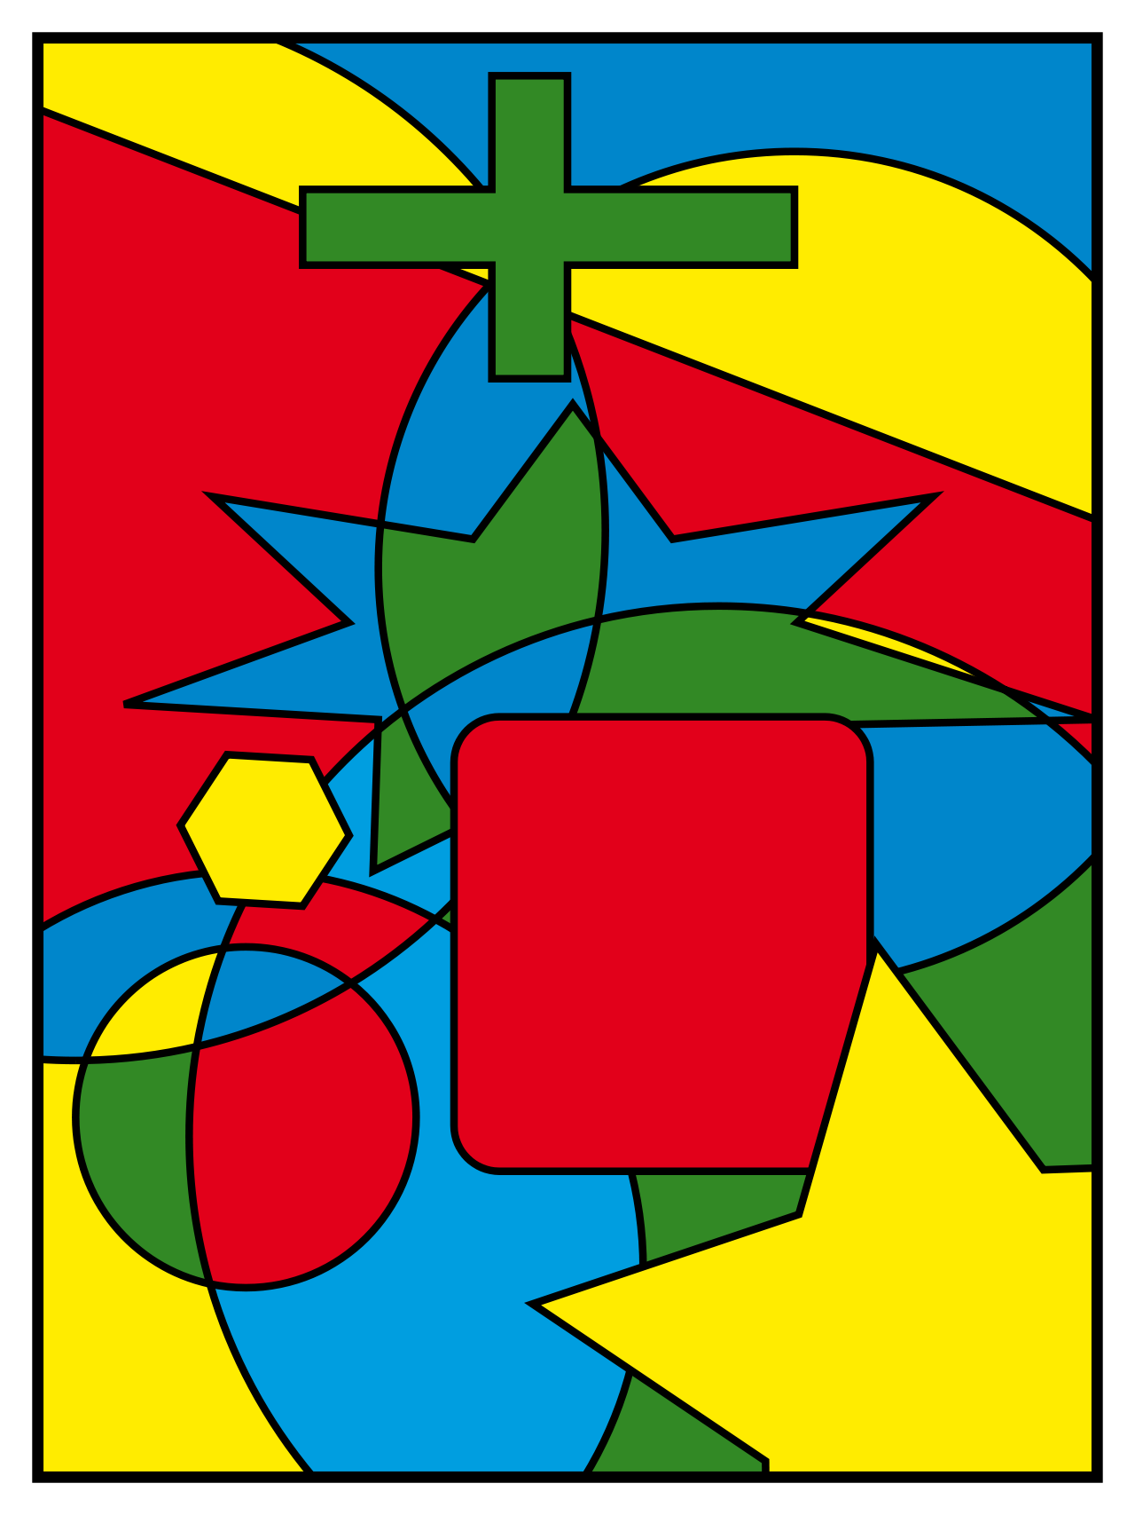
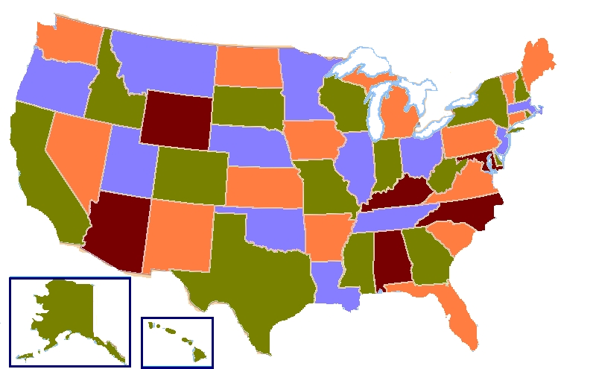

Slide 18
The four outstanding mathematics problems
The four color conjecture, proved in 1976 by Kenneth Appel and Wolfgang Haken, case closed.
The Poincare conjecture, proved in 2002 by Grigori Perelman, case closed.
The Format conjecture, proved in in 1994 by Andrew Wiles, case closed.
The Goldbach conjecture, not proved, case open. Second best result by Jingrun Chen in 1973.

Slide 19
Summary of previous class
Graph as a collection of vertices and edges
Simple graph, directed graph, multigraph, bipartite graph
Path, circuit, connectivity
Isomorphism
Complete graph, complete bipartite graph, complement
Subgraph, symmetry, assumption and consequence

Slide 20
Are these two graphs isomorphic to each other?

Slide 21
Are these two graphs isomorphic to each other?

Slide 22
Are these two graphs isomorphic to each other?

Slide 23
Are these two graphs isomorphic to each other?
Degree counting:
Left: 2, 3, 3, 3, 3
Right: 2, 2, 3, 3, 4

Slide 24
Are these two graphs isomorphic to each other?

Slide 25
Are these two graphs isomorphic to each other?

Slide 26
Are these two graphs isomorphic to each other?

Slide 27
Are these two graphs isomorphic to each other?

